Slide 1

Quantum oddities: The revenge
Ambroise LAFONT

Slide 2
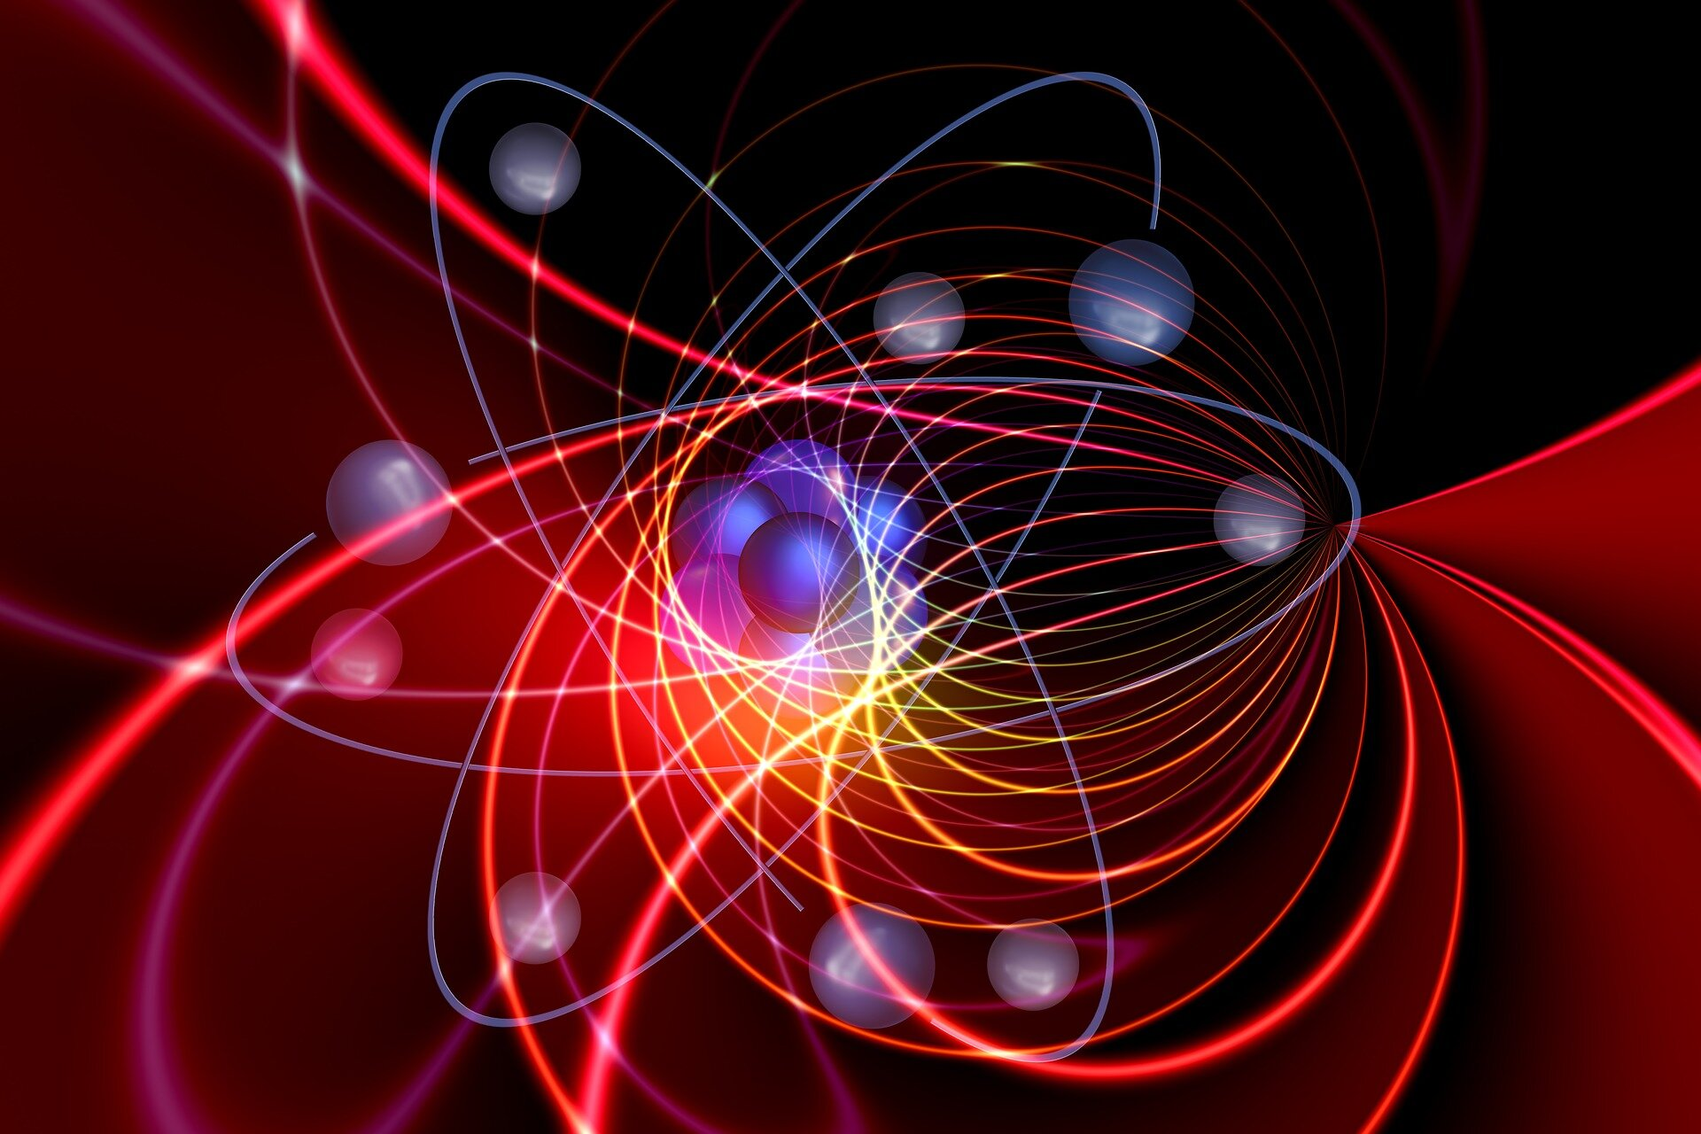
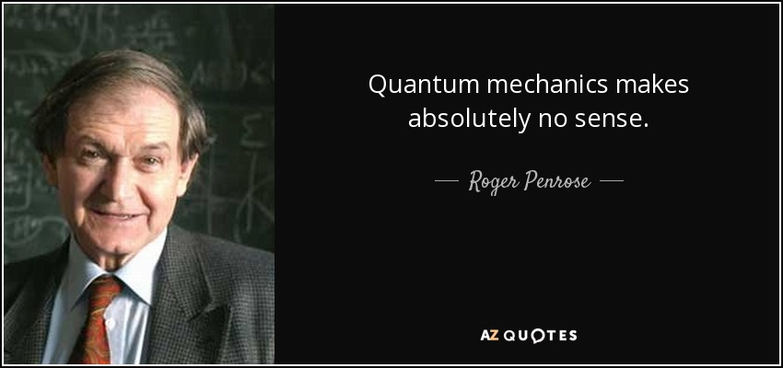
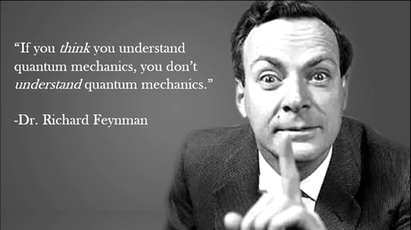
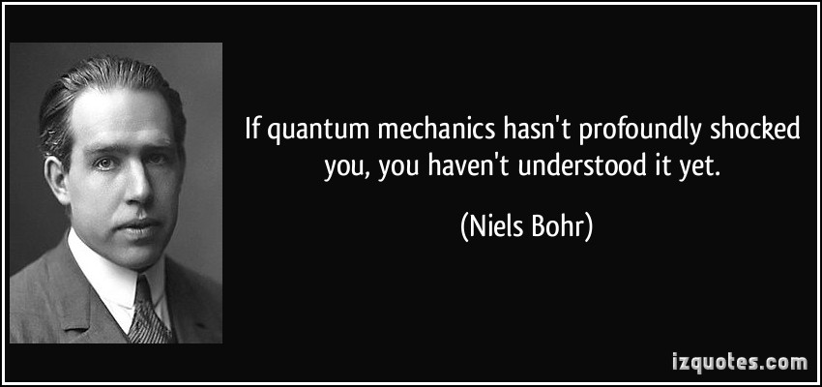

Slide 3
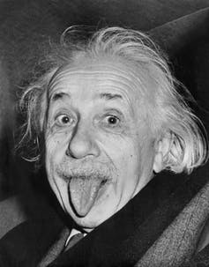
I. Bell’s theorem
A gedanken experiment presented in the first page of
The outcome predicted by quantum mechanics challenges the locality principle, at the basis of Einstein’s relativistic theories
“The Best Version of Bell’s Theorem”, Mermin 1995
Causality has a maximal speed limit: the speed of light
E = mc²
What happens here cannot affect instantaneously what happens there.

Slide 4




A long time ago in a galaxy far, far away...
A crazy scientist prepares two mysterious « Bell boxes » and send them very far away from each other.
light
switch

Slide 5

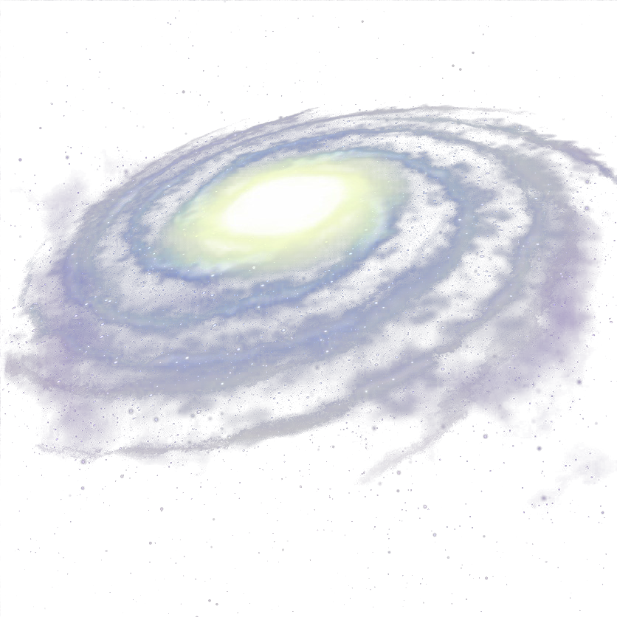





Alice and Bob Skywalker find the boxes at the opposite edges of the galaxy.
Long distance
Inspired by the force, each second they simultaneously choose a random switch position, then record if their light is on.

Slide 6




Back at the jedi academy, Alice and Bob merge their records.
Alice’s switch
& light
Bob’s switch
& light
Round 1
Round 2
These black boxes do not behave like regular lamps
Round 3
Yeah, looks random
Round 4
…

Slide 7


Bell rules
Symmetric
Verifiable
Quantum mechanics allow to construct black boxes s.t.
Both lights may be off even if both switches are on
(sometimes)
If both switches are off, at least one light is off
If exactly one switch is on, at least one light is on

Slide 8
Locality principle for Bell’s boxes
Long distance
If Bell’s boxes are far enough from each other, the switch position of a box cannot affect the light state of the other box.

Slide 9

(1)
sometimes
(2)
(3)
⇒
Contradiction
+
For each round ,
if instead the switches were off, we would have
got a round , thus
contradicting rule (2)
Proof: next slides

Slide 10
Overview of the proof
Real world
Hypothetical courses of events
Alice’s switch
& light
Bob’s switch
& light
What if I had switched off?
What if I too had switched off?
Round 1
Round 2
/
/
/
/
Round 3
Alternative world 1
Alternative world 2
Round 4
…

Slide 11
Alternative 1
Real world
Hypothetical courses of events
Alice’s switch
& light
Bob’s switch
& light
What if I had switched off?
Round 1
Alternative world 1
Round 2
/
/
?
Round 3
Round 4
…

Slide 12
Alternative 1
Real world
Hypothetical courses of events
Alice’s switch
& light
Bob’s switch
& light
What if I had switched off?
Round 1
Alternative world 1
Round 2
/
/
?
Round 3
I don’t care about the other switch.
Round 4
…

Slide 13
Alternative 1
Real world
Hypothetical courses of events
Alice’s switch
& light
Bob’s switch
& light
What if I had switched off?
Round 1
Alternative world 1
Round 2
/
/
?
Round 3
Bell’s rule (3)
Round 4
…

Slide 14
Alternative 2
Alternative world 1
Real world
Alice’s switch
& light
Bob’s switch
& light
What if I too had switched off?
Round 1
I don’t care about the other switch.
By a similar (symmetric) argument
Round 2
/
/
Round 3
Round 4
Alternative world 2
…

Slide 15


What have you done / proven?
(1)
sometimes
(2)
For each round ,
if instead the switches were off, we would have
got a round , thus
contradicting rule (2)
⇒
(3)
+

Slide 16


Non-local the universe is.
In 1964, John Bell suggested how to construct such black boxes using (intricate) quantum particles.
Wikipedia mentions 18 successful Bell tests performed between 1972 and 2018, all confirming the predictions of quantum theory against locality.

Slide 17


How useful is quantum non-locality?
Non-locality: In quantum mechanics, what happens at one place can instantaneously affect the state of a distant place.
Yet,
No-communication theorem: quantum non-locality does not allow faster-than-light communication.
Idea of the proof: quantum indeterministic features blurs the message.
Did she mean it, or is this the product of quantum randomness?

Slide 18
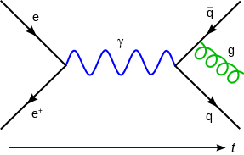
Is quantum mechanics compatible with relativity?
E = mc²
locality principle: fundamental in Einstein’s theory
denied by quantum mechanics
Is this why it is so hard to unify general relativity and quantum mechanics?
I don’t know.
Quantum field theory: (successful) adaptation of quantum mechanics to special relativity (= a particular case of general relativity).
Used to predict what happens in particle colliders (e.g., LHC)
Basis for our current « standard model » = catalogue of elementary particles (e.g. quarks)

Slide 19
Conclusion
Our universe is not local.

Slide 20
And since I have some time left...
The measurement postulate is responsible for the indeterministic (and non-local) features of quantum mechanics.
« When a measurement occurs, the wavefunction of the observed system collapses ».

Slide 21


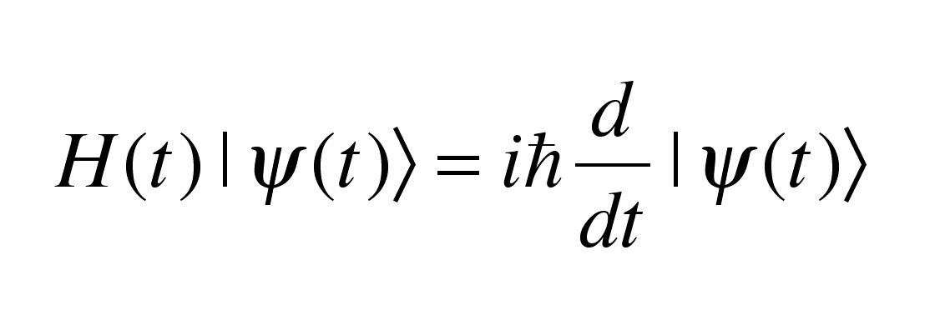
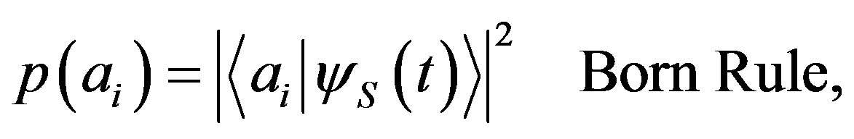

Quantum course of events
…
p(a _{i})
…
Quantum evolution
Deterministic
Local
Wave function collapse
Non-Deterministic
Non-Local
p(a _{i’})
…
« When a measure occurs, the state of the observed system evolves instantaneously and randomly towards one of the possibles outcomes: … »
Schrödinger equation
Born rule
Weird (quantum) states
Classical states

Slide 22




Classical picture

Slide 23


Such a tidy wardrobe
Before we open the eyes, the world is in a quantum mess
Quantum picture
Wavefunction collapse
Quantum superposition
Things get definite properties (such as position)

Slide 24
Quantum mess
Quantum superposition: things may not have definite positions
Not observable
Quantum mechanics was invented to model our observations, but it predicts some unobservable states...
Not even representable!
Makes no sense to wonder what this state looks like

Slide 25



Disproving the quantum mess
I take a photo, eyes closed.
The photo shows a classical wardrobe!

Slide 26

Some possible quantum accounts
(1)
Wavefunction collapse
Wavefunction collapse
(2)
what counts as a measurement? The measurement postulate doesn’t tell…

Slide 27
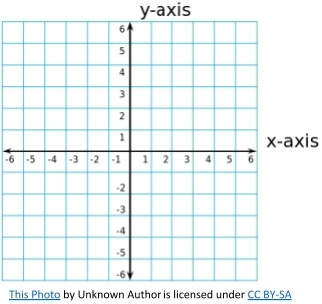


Wave/particle duality: indeterminism
Wavefunction collapse
Wavefunction collapse
The particle has no definite position
The particle gets a random definite position (according to some probability distribution)

Slide 28
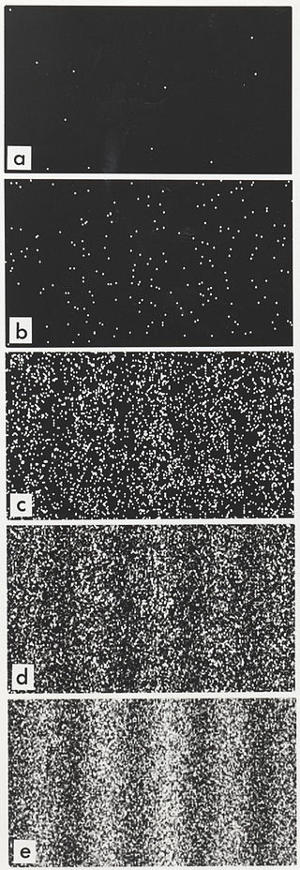
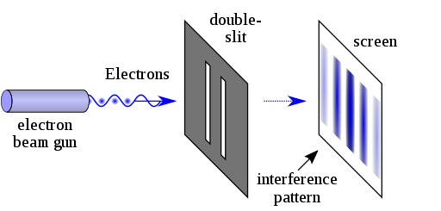
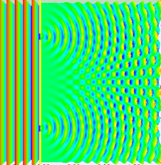
Electron buildup over time, on the screen
Proving the quantum mess:
The double-slit experiment
First experiment in 1801, by Thomas Young, for light
Until it is detected (hits the screen), the electron « behaves » like a wave:
before the wavefunction collapse, the electron « behaves » like a wave.

Slide 29

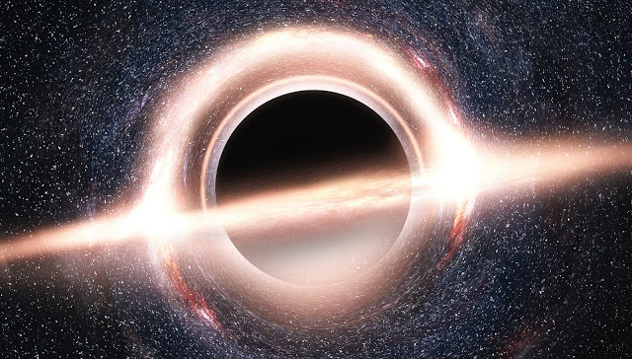
Non-locality
Before we observe distant stars, they are potentially in a quantum mess
Wavefunction collapse
A gargantuan black hole

Slide 30


Paradox of ancestrality
How was the world before the first measurement?
Wave-function collapse
First sentient creature
Who was first?
Earth
supports

Slide 31




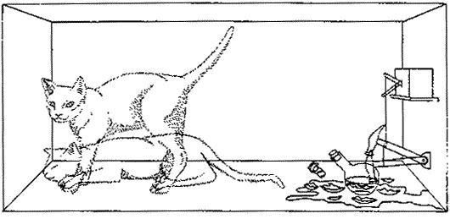
The Schrödinger cat gedankenexperiment (1935)
Some say that the cat is both « alive and dead » at this stage (I would rather say that there is no cat).
a cat is put in a prepared box
The inside of the box evolves according to quantum mechanics
At this time, there is no « cat » inside the box
When we open/measures the box, the cat instantaneously reappears, either dead or alive
or
Episode 1
An alive cat is put in a prepared box
Episode 2: Quantum mess
Superposition of states « alive/dead »
Episode 3: Measurement
The cat is found either dead or alive (non deterministically)
Meow! Why wouldn’t I be able to « measure »?

Slide 32

Wigner’s friend gedankenexperiment
Some say that the cat is both « alive and dead » at this stage (I would rather say that there is no cat).
a cat is put in a prepared box
The inside of the box evolves according to quantum mechanics
At this time, there is no « cat » inside the box
When we open/measures the box, the cat instantaneously reappears, either dead or alive
or
Episode 1
Alice pushes Bob in a prepared box
Episode 2: Quantum mess
Superposition of states « alive/dead »
Episode 3: Measurement
Introduced by Wigner in 1961
Wigner’s (controversial) point: consciousness is responsible for wavefunction collapse

Slide 33
Intersubjectivity?
Some say that the cat is both « alive and dead » at this stage (I would rather say that there is no cat).
a cat is put in a prepared box
The inside of the box evolves according to quantum mechanics
At this time, there is no « cat » inside the box
When we open/measures the box, the cat instantaneously reappears, either dead or alive
Bob’s account
Bob appears with (fake) memories of him being alive before opening the box
Alice’s account
(Relational interpretation of QM: this discrepancy is just the result of "changing the reference frame", similarly to what happen in general relativity!)

Slide 34
What is a measurement?
The measurement postulate is very useful, but it does not tells us what a measurement is!
It looks also dubiously subjective.
If noone is there to read a measuring device, does the measurement postulate applies?
⇒ multiple interpretations of quantum mechanics

Slide 35

Some popular solutions to the measurement problem
I don’t understand
Copenhagen interpretation: historically, the first mainstream one
Explain when a wavefunction collapses, e.g.,
When involving « big » enough objects,
When a « mind » enquires about the world
Remove the measurement postulate
Multi-worlds
Bohmian mechanics
I understand
I don’t agree
Origin of indeterminism/non locality?
I don’t understand
I understand
Not so popular because « very » non-local
Notes:
20 minutes

Slide 36
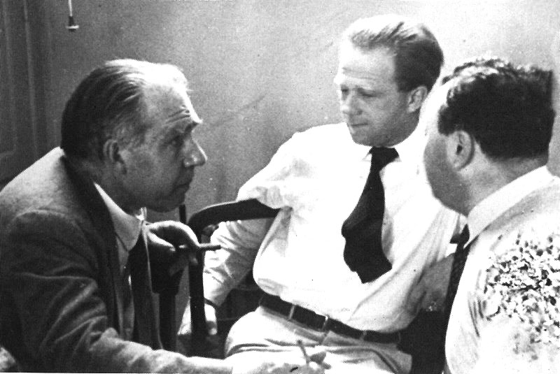
Copenhagen school
Quantum mechanics with the measurement postulate, as I have described so far.
« Physics is about predicting the outcome of observations, nothing more. »
Bohr, Heisenberg, Pauli

Slide 37
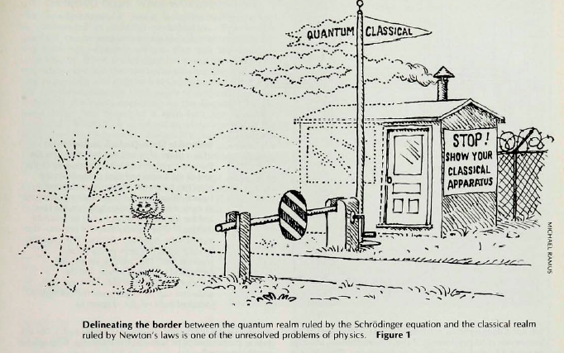
Spontaneous wave function collapse at large scale?

Slide 38
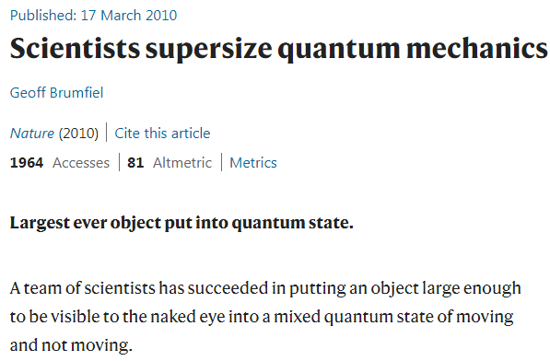
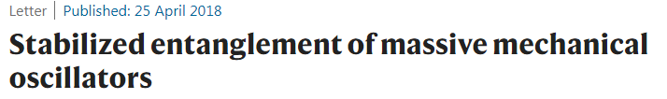
How big can an object be before the collapse?
The frontier between quantum and classical keeps being pushed up.

Slide 39
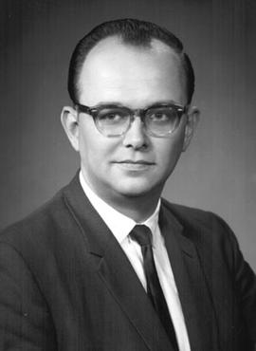

Many-world interpretation
Originated in Everett's Princeton Ph.D. thesis "The Theory of the Universal Wavefunction", 1957
No measurement postulate
the world splits in as many worlds as possible outcomes each time a wavefunction collapse would have led to different outcomes

Slide 40
Universe – a bifurcations tree
Life
Homo
sapiens
.......
.......
. . . . . .
Current world.
.......
.......
A variant ”Many minds”
“Probability” for Life → Hom.sap. → Current world extremely small.
The splitting of the world occurs in the mind of each observer rather than objectively
All branches remain – no collapse of wave function

Slide 41
My concerns with the many-world interpretation
Why am I aware only of this particular world?
Where does the observable indeterminism come from, if not from the measurement postulate?
How to explain the observed Born rule (observed probability distribution)?
Answer:
Wallace, David (2009). "A formal proof of the Born rule from decision-theoretic assumptions"

Slide 42
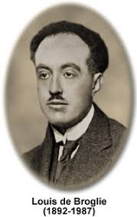
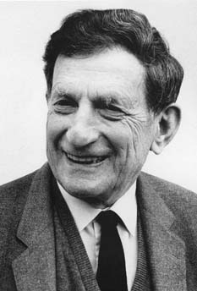
Bohmian mechanics
Origin:
de Broglie’s pilot wave theory in the 1920s
in 1927, was persuaded to abandon it in favour of the then-mainstream Copenhagen interpretation
David Bohm, dissatisfied with the Copenhagen interpretation rediscovered de Broglie's pilot-wave theory in 1952.
widely deemed unacceptable by mainstream theorists, mostly because of its explicit non-locality

Slide 43
Features of Bohmian mechanics
Remove the measurement postulate
Non-locality?
The Schrödinger equation is modified and becomes non-local
Indeterminism?
Observed indeterminism = ignorance of the initial state
No quantum superposition

Slide 44
Conclusion
The universe is non-local.
Quantum mechanics is hard to interpret.
I like Bohmian mechanics (although I don’t know the details)

Slide 45






Paradox of ancestrality
How was the world before the first measurement?
big
More and more accurate « observers » come to life
Increasing wavefunction collapses
Earth did not exist before the first (earth) observer?
Earth observer cannot exist before Earth?

